Slide 1
Molecular Model of an Ideal Gas

Slide 3
Question 123.14.1.5
A car is driving down I-20 at 70mph (the new speed limit). Does the center of mass of the car have the same kinetic energy as a piston in the engine?
Yes
No
Maybe
Wait, the speed limit changed?

Slide 4
Question 123.14.1
We have two gases, each with the same values of n, V and T. One gas is Hydrogen, the other is Nitrogen. For which gas is the rms speed larger?
Hydrogen
Nitrogen

Slide 5

v_{system}
v_{molecule}
V
P
n
T

Slide 7
Question 123.14.2
If the temperature increases, the peak of the Maxwell-Boltzmann speed distribution
Increases to a higher velocity
Decreases to a lower velocity
Stays the same
Can’t tell

Slide 8
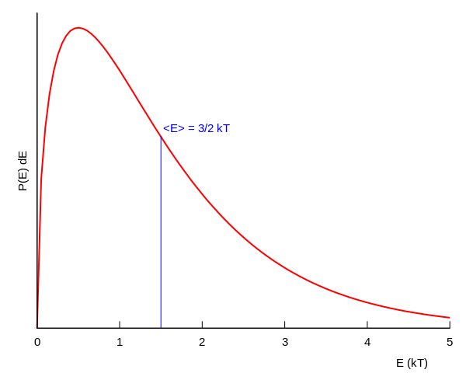
Boltzmann Distribution

Slide 9
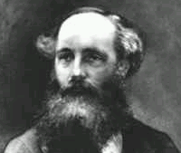
Found an expression for the Molecular Speed Distribution
James Clerk Maxwell (1831-1879)

Slide 10
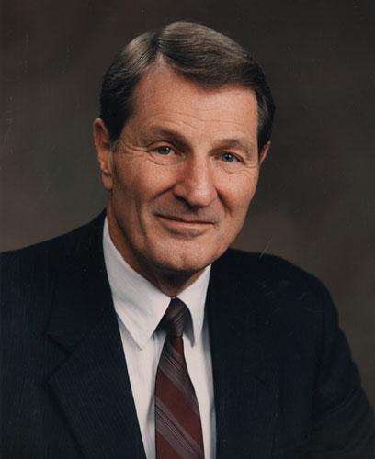
Not the same guy
Neal A. Maxwell
(1926-2004)

Slide 11
N - total number of molecules

Slide 12
Question 123.14.2
If the temperature increases, the peak of the Maxwell-Boltzmann speed distribution
Increases to a higher velocity
Decreases to a lower velocity
Stays the same
Can’t tell

Slide 13
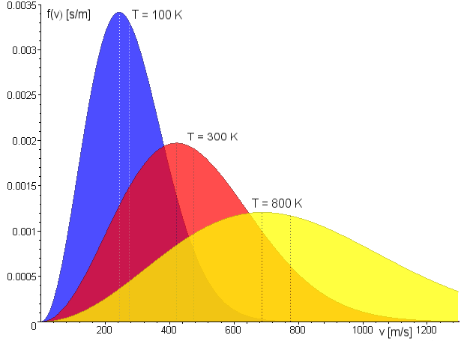
Maxwell Distribution
A system of gas at a given temperature will exhibit a variety of speeds
Three speeds are of interest:
Most probable
Average
rms
Image in the Public Domain couracy Fred Stober

Slide 14
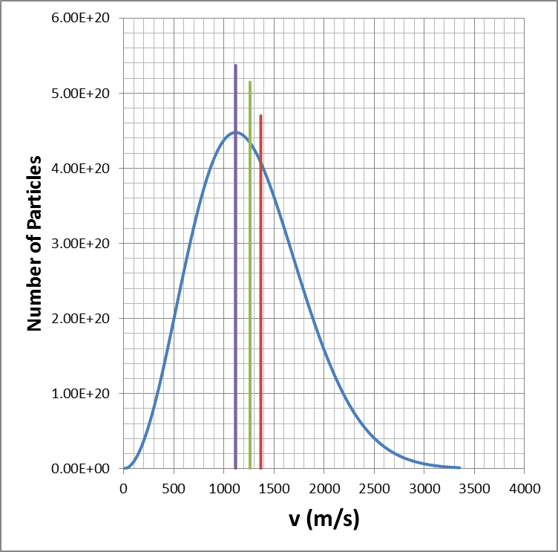
Molecular Speeds

Slide 15
Question 123.14.4
Two gases have the same number of molecules, the same volume, pressure, and temperature. Gas A has molecules that are twice the size of gas B. The mean path of A is
¼ the mean free path of B
½ the mean free path of B
Twice the mean free path of B
4 times the mean free path of B

Slide 16
Mean Free Path
The average distance between collisions. Depends on:
diameter of the molecules
density of gas
Random-walk process

Slide 17
Equivalent Collision
Collision
Equivalent Collision
d
d
d
d

Slide 18
L
2d

Slide 19
Mean Free Path
Collision Frequency
Random-walk process

Slide 20
Mean Free Path
For air molecules at room temperature:
(Molecule separation distance is 3.4x10⁻⁹ m.)

Slide 21
Partial Summary
Mean Free Path
Problems to try 21.45, 21.61
Extra Credit: Write up why the square root of 2 was needed

Slide 22
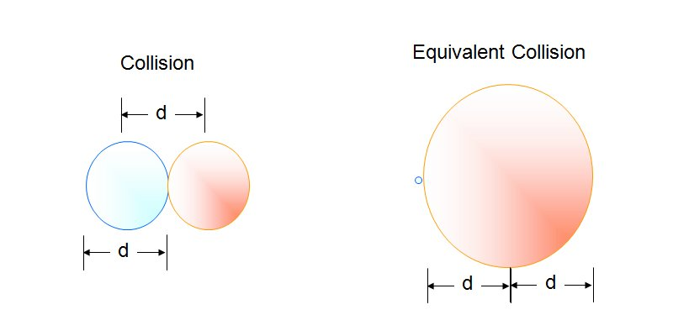

Slide 23
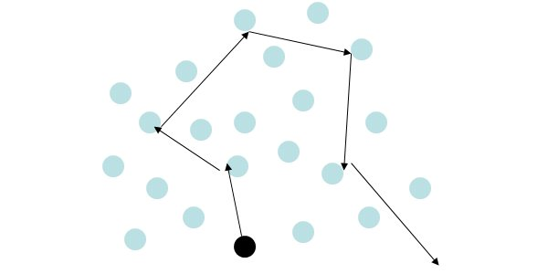

Slide 24
Assumptions
The number of molecules in the gas is large and the average separation between them is large compared to their dimensions
The molecules obey Newton’s laws of motion, but as a whole they move randomly

Slide 25
Assumptions, cont.
The molecules interact only by short-range forces during elastic collisions
The molecules make elastic collisions with the walls
The gas under consideration is a pure substance, all the molecules are identical

Slide 26
Question 123.14.5
A ball bounces off a wall. If the initial velocity of the ball is v_{x} and the final velocity of the ball is –v_{x}, what is the change in momentum of the ball?
mv_{x}
0
-mv_{x}
2mv_{x}
v_{x}
-v_{x}

Slide 27
Particle in a Box
d
v
d
v_{x}

Slide 28
Momentum of the Collision
v_{x}
-v_{x}

Slide 29
Question 123.14.5
A ball bounces off a wall. If the initial velocity of the ball is v_{x} and the final velocity of the ball is –v_{x}, what is the change in momentum of the ball?
mv_{x}
0
-mv_{x}
2mv_{x}
v_{x}
-v_{x}

Slide 30
Average Force and Impulse
F
t
F
F
F
t
t
F
t

Slide 31
Question 123.14.7
What is the name of this quantity?
Kale-Gordon factor
Boltzmann's factor
The average value of x
The standard deviation of x

Slide 32
Question 123.14.8
We learned a name for what is that name?
b)
c)
d) Craig

Slide 33
Some rms Speeds

